Slide 1
Surveying the Cyberspace
Cybersecurity Day 2

Slide 2
Class Objectives
By the end of class today, students will be able to:
Articulate a clear definition of the CIA Triad and its elements.
Define and contextualize technical terms found in recent cybersecurity trends and reports.
Utilize cybersecurity trend reports to communicate risk patterns.
Conduct and present analysis on a vulnerability, exploit, or threat actor to a non-technical audience using independent research.

Slide 3
Let’s do a quick review!

Slide 4
Quick Review
Last class, we described cybersecurity as centering on two concepts.
What were they?

Slide 5
Quick Review
Last class, we described cybersecurity as centering on two concepts.
What were they?
Threat Assessment and
Risk Mitigation

Slide 6
Quick Review
How would you define these terms?
Threat Assessment
Risk Mitigation

Slide 7
Quick Review
How would you define these terms?
Threat Assessment
Structured process of identifying the risks posed to a group or system.
Risk Mitigation
Systematic reduction of the impact and/or the likely occurrence of a negative event.

Slide 8
Quick Review
In other words...
Threat Assessment
What Could Happen???
Risk Mitigation
How Do we Handle It???

Slide 9


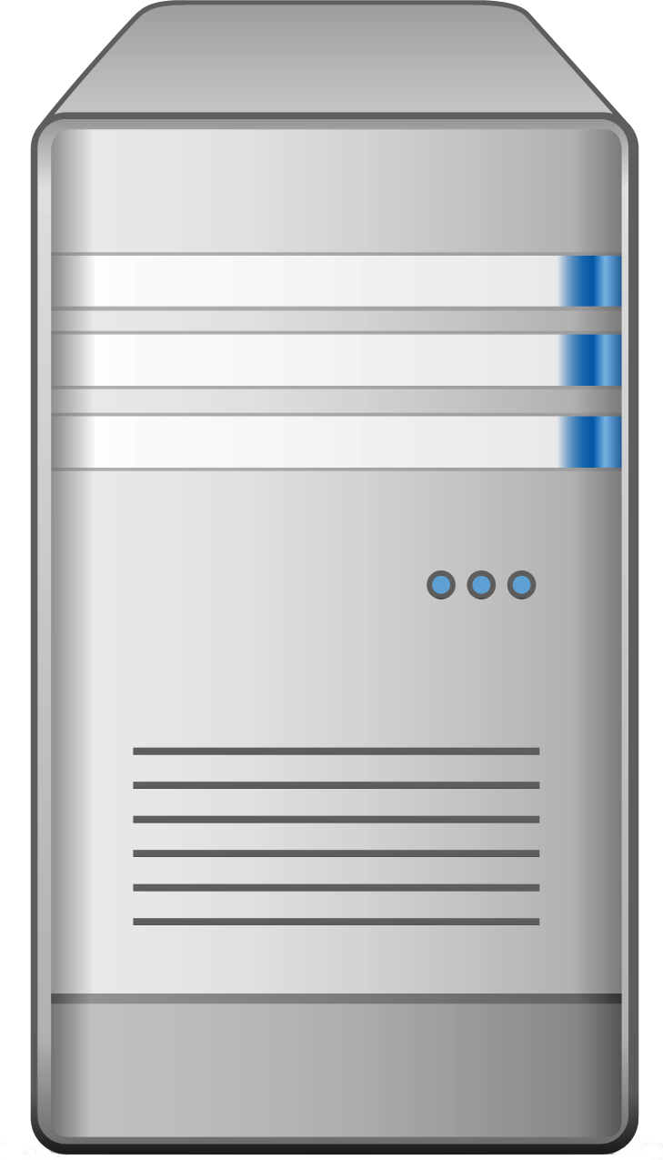

Quick Review
Last class, we talked about a situation in which we were offering advice on a vulnerable login.
Login
Web Login
Server
Data
Which elements of this diagram did we conclude were potential targets?
Users and Admins

Slide 10
Quick Review
All of them!
Login
Web Login
Server
Data
In every case, an attacker could target every node along the chain.
Users and Admins

Slide 11
Quick Review
Name Three User Attacks
Users and Admins

Slide 12
Quick Review
Name Three User Attacks
Malware Attacks
Man in the Middle
Social Engineering
Packet Sniffing
Credential Reuse
Computer Theft
Users and Admins

Slide 13
Quick Review
Name One Website Attack
Login

Slide 14
Quick Review
Name One Website Attack
Login
Brute Force Injection
Code Injection
Session Stealing

Slide 15
Quick Review
Name One Server Attack

Slide 16
Quick Review
Name One Server Attack
OS Exploits
Code Injection

Slide 17
Quick Review
Name One Database Attack

Slide 18
Quick Review
Name One Database Attack
Default Credentials
Unpatched Database
Lack of Segregation

Slide 19
Quick Review
User Attacks
Web Attacks
Database Attacks
Social Engineering
Brute-Force Attacks
Default Credentials
Phishing Attacks
Code Injection
Unpatched Database
Credential Reuse
Faulty Sessions
Lack of Segregation
Malware Attacks
Server Attacks
Man in the Middle
Name three Risk Mitigation Options
OS Exploit
Packet Sniffing
Malicious Software
Computer Theft

Slide 20
Quick Review
Name Three Risk Mitigation Options
1. Educate all users on dangers of phishing and social engineering
2. Ensure passwords are truly unique to website (require characters atypical of other websites).
3. Ensure users are using multi-factor authentication (login + phone confirmation).
4. Ensure administrators can only access the network from a secure location (on premises).
5. Ensure passwords used are strong (alphanumeric + symbols).
6. Ensure login fields do not accept any code insertions.
7. Ensure users are immediately signed off upon closing a browser.
8. Ensure all servers are routinely patched against latest known vulnerabilities.
9. Ensure physical access to servers is protected by multiple forms of authentication
10. Ensure that all data stored in the database is encrypted and cannot be read without additional login information.
11. Ensure that all cloud security platforms follow best practices for security implementation.

Slide 21
Oh look, a Phone...
Last class, two students left their phones unattended at some point.
With the person sitting next to you, identify as many exploits possible in the event of a cell phone being stolen.
Hint: Be creative! Think like a hacker. What is the worst possible damage that could ensue. Try to do real damage. Think beyond the value of the phone itself.

Slide 22
Let’s Review: Oh look, a Phone...
Potential Adverse Event
Cell phone can be wiped (cleared) and re-sold.
Cell phone memory can be harvested. Photos and sensitive material could be used for blackmail.
Credentials for email and social media accounts could be used to extract financial gain.
Installed applications could be used to make purchases.
Malware software could be directly installed to track future activity
Contacts on your phone could be socially engineered into providing monetary value.
Your phone could be used to conduct illegal activity.
Your identity could be stolen.

Slide 23
The CIA Triad

Slide 24

The InfoSec Bible: The CIA Triad
1
AVAILABILITY
2
INTEGRITY
INFORMATION
SECURITY
3
CONFIDENTIALITY

Slide 25
Activity: Define CIA Triad
In the next activity, we’ll dive deeper into the meaning of each component of the CIA Triad.
5 Minutes

Slide 26
Your Turn: Define the CIA Triad
Instructions
Working with the person seated next to you:
1. Using a standard dictionary, take a few moments to define each element of the CIA Triad: Confidentiality, Integrity, and Availability.
2. Then, spend a few moments researching how these words translate in an information security context.
3. Then, think of 1-2 practical cases in which each element of the CIA triad could be impacted by an attack or breach.

Slide 27
CIA Triad Review
Confidentiality
Formal Definition:
The state of keeping or being kept secret or private.
IT Definition:
Ensuring sensitive information does not reach unauthorized people.
Example of Attack:
Private photos released on a forum.
Credit card numbers uncovered and exposed online.

Slide 28
CIA Triad Review
Integrity
Formal Definition:
The quality of being honest, whole, or undivided.
IT Definition:
Protected from modification by unauthorized parties.
Example of Attack:
Intercepted money transfer has the dollar amount insignificantly changed, allowing excess to be siphoned off.
Grades in university record system are modified to better grades.

Slide 29
CIA Triad Review
Availability
Formal Definition:
The quality of being able to be used or obtained.
IT Definition:
Operating systems, equipment and data are accessible and functioning correctly for those who need it.
Example of Attack:
Hackers take down a web connected generator in a hospital.
Hackers use DoS attack to bring down financial service provider’s website.

Slide 30
Threat Landscape

Slide 31
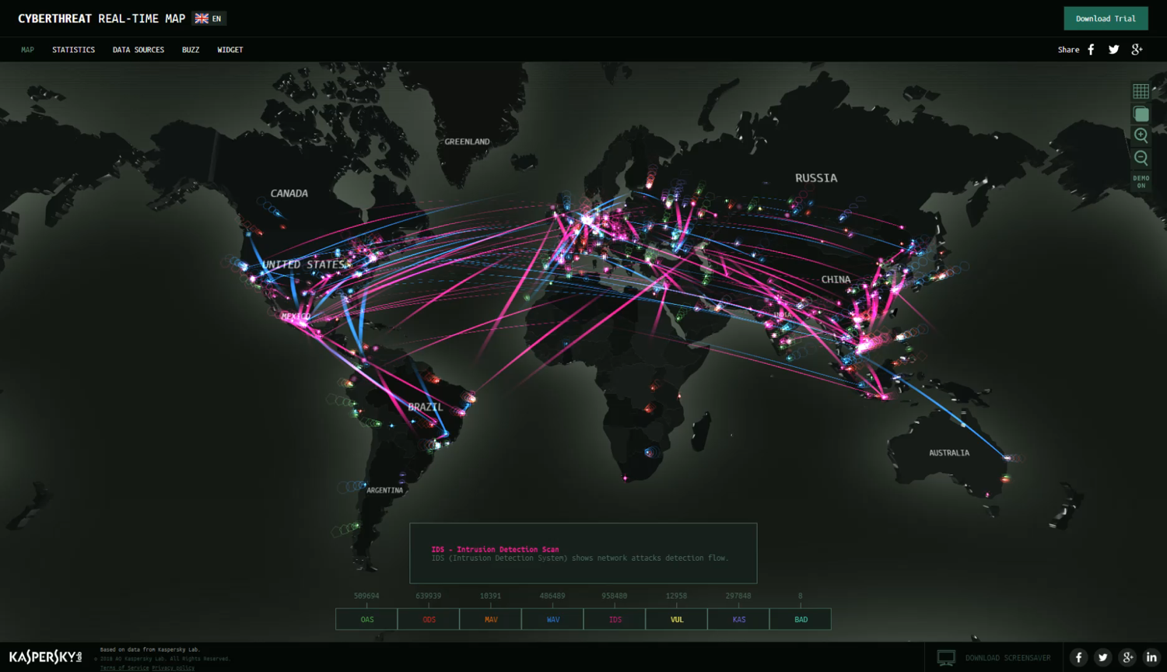
Cyber Attack Maps (Kaspersky)
Threat maps visualize the current cybersecurity landscape, providing a great overview of “real-time” security threats.
Notes:
Image Source: Screen grab from https://cybermap.kaspersky.com/

Slide 32
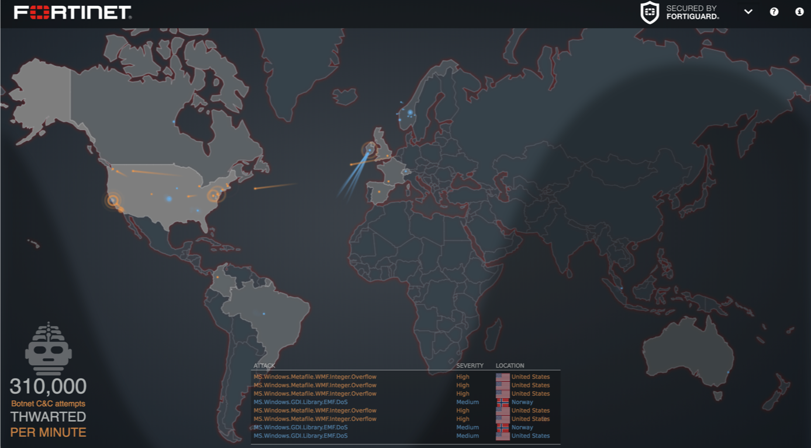
Cyber Attack Maps (Fortinet)
Threat maps visualize the current cybersecurity landscape, providing a great overview of “real-time” security threats.
Notes:
Image Source: Screen grab from https://threatmap.fortiguard.com/

Slide 33
Activity: Kaspersky + Fortinet Map Exploration
In this activity, you will navigate through Kaspersky and Fortinet maps and uncover what is displayed, what terminology arises, and any visible trends.
7 minutes

Slide 34
Your Turn: Kaspersky + Fortinet Map Exploration
7 Minutes
Instructions:
Spend a few minutes playing around with the Kaspersky and Fortinet Threat Maps and, while on these websites, answer the following questions:
Link: https://threatmap.fortiguard.com/
https://cybermap.kaspersky.com/
What exactly are these websites showing?
Are there any terms used on these websites that you are unfamiliar with? Find and define at least three.
Are there any trends that stick out to you? Look for at least two.

Slide 35

Reports, Blogs, and Research
Threat maps are fun visuals, but cyber professionals rely on prominent reports, blogs, and papers to stay up to date on the specific landscape.
Schneier on Security
KrebsonSecurity
GRAHAM CLULEY
Security Weekly
CSO
TaoSecurity

Slide 36
In the next few activities, you will use three prominent security reports to better understand the contemporary security landscape.

Slide 37
Activity: Vocabulary Research
In this activity, you will pair up, navigate through a report and complete a vocabulary worksheet as you progress.
Instructions sent via Slack.
15 Minutes

Slide 38
Your Turn: Vocabulary Research
15 Minutes
Instructions:
Using the reports provided, complete the sections of the worksheet pertaining to the "Symantec Internet Security Threat" report.
Notes:
Be extra mindful of defining words in a way that a lay person would understand. Don’t rely on one technical term to define another. Break it down to a form you truly understand.
Use outside research when necessary to define the terms, but use the reports provided when explaining their significance. It’s important that you get comfortable reading technical documentation to draw out context.
Copy the assignment into a new Google Doc before getting started. You will be submitting this assignment later in the week as your first “homework” assignment, but aim to complete at least the Symantec section by the end of class today.

Slide 39
Vocabulary Research

Slide 41
Activity: Report Analysis
Now you will continue navigate through the provided articles and complete the Symantec Internet Security Threat report analysis worksheet
Instructions sent via Slack.
15 Minutes

Slide 42
Your Turn: Report Analysis
15 Minutes
Instructions:
Working in pairs of two and using the reports provided, complete the section of the worksheet pertaining to the Symantec Internet Security Threat report.
Notes:
For each questions, use a combination of the reports provided and your independent judgement.
Again, remember to answer questions in a way that would make sense to a lay person when possible. Don’t feel content just writing down technical jargon.
Copy the assignment into a new Google Doc before getting started. You will be submitting this assignment later in the week as your first “homework” assignment, but aim to complete at least the Symantec section by the end of class today.

Slide 43
Report Analysis

Slide 44
Activity: Threat Research
In this activity, you will group up in 3-4, and research an assigned vulnerability, exploit, or threat actor.
Instructions sent via Slack
40 Minutes

Slide 45
Your Turn: Threat Research
40 Minutes
Instructions:
Working in groups of three or four, you will be assigned a vulnerability, exploit, or threat actor.
Your task is to: Prepare a 5 minute presentation that provides an overview of the topic. Focus on answering the following question:
What is or was the exploit, vulnerability, or threat actor?
What damage has it done?
What steps have or can be taken to mitigate the damage?
Notes:
While you may be new to the field challenge yourself to “become the expert.” A huge part of being a security professional is getting up to speed quickly on technical situations using research.
For those uncomfortable about the idea of presenting, challenge yourself to treat this as a safe place. Becoming a confident speaker is an important part of being a cybersecurity consultant that people can trust.

Slide 46
Threat Research

Slide 47
Homework Assignment:
You will present your research next class.
Additionally, you should complete the worksheets started in class. Check Bootcamp Spot for due dates.

